Slide 1
Lines of Equipotential

Slide 2
Equipotential Lines
Equipotential lines denote where the electric potential is the same in an electric field.
The potential is the same anywhere on an equipotential surface a distance r from a point charge, or d from a plate.
No work is done to move a charge along an equipotential surface. Hence V_{B} = V_{A}
Work is the same regardless of the path taken by a charge from point A to point B in an electric field.(The electric potential difference does not depend on the path taken from A to B).
Electric field lines and equipotential lines cross at right angles and point in the direction of decreasing potential.
$V=kq/r$(point charges)
$V=Ed$(parallel plate)

Slide 3
Equipotential Lines
Parallel Plate Capacitor
+
+
+
+
+
+
+
+
+
+
+
++++
Lines of Equipotential
-
-
-
-
-
-
-
-
-
-
-
----
Electric Field Lines
$$V=Ed$$
Note: Electric field lines and lines of equipotential intersect at right angles.
+4V
V
s
$$d$$
-4V
s=0
s=d
+4V
+3V
+2V
+1V
0V
-1V
-2V
-3V
-4V
Decreasing Electric Potential / Voltage

Slide 4
Equipotential Lines
Point Charge
Note: Electric field lines and lines of equipotential intersect at right angles.
Lines of Equipotential
$$V=kq/r$$
+
V
Electric Field Lines
r
Note: A charged surface is also an equipotential surface!
Decreasing Electric Potential / Voltage

Slide 5
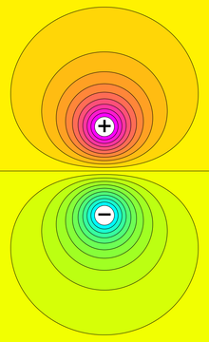
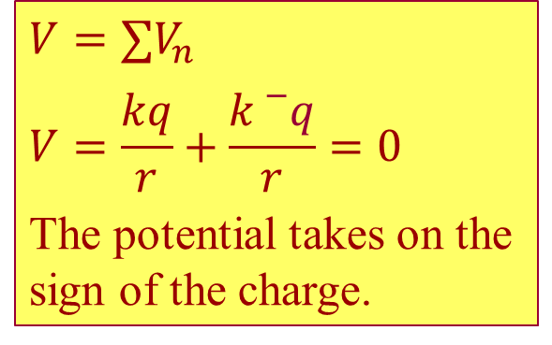
The Electronic Dipole:
Lines of Equipotential
V = 0
Electric Field Lines
$$V=∑V_{n}$$
$$V=\frac{kq}{r}+\frac{k{}_{}^{−}q}{r}=0$$
The potential takes on the sign of the charge.
Why is the electric potential at the midpoint zero?

Slide 6
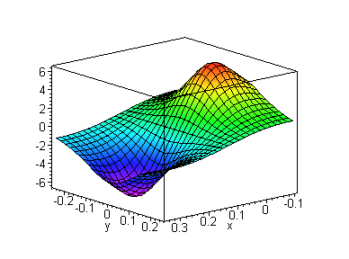
A Contour Map of an Electronic Dipole
Zero Potential
Positive Charge/
High Potential
Negative Charge/
Low Potential

Slide 7
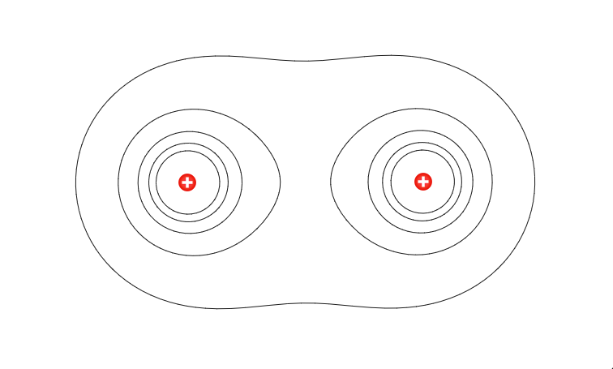

Lines of Equipotential for Like Charges
Lines of Equipotential
Electric Field Lines
$$V=∑V_{n}$$
$$V=\frac{kq}{r}+\frac{kq}{r}=2\frac{kq}{r}$$
Electric Field = 0
Is the electric potential at the midpoint zero?
No. Why?

Slide 8
Equipotential Lines (Examples)
http://www.cco.caltech.edu/~phys1/java/phys1/EField/EField.html

